Slide 1


Predicting Stock Market Movements and Volatility
Empowering Investors with Data-Driven Insights
Team Members:
Sarika Sharma
Ariana Breckenridge
Richard Wallace

Slide 2



Problem Statement
Stock market investment decision SHOULD NOT BE a coin toss
Imagine having a crystal ball for the stock market. What if you could reliably anticipate its twists and turns? That's the power we're talking about here. Accurately predicting market fluctuations isn't just a clever trick—it's a game-changer for investors. It's about protecting their hard-earned money, their life savings, from the unpredictable tides of the market. Reliable predictions empower investors to make smart, informed choices, minimizing risks and maximizing returns. Think of it: better investment strategies, stronger portfolios, and a shield against devastating financial losses. Cracking this code means building a more stable and confident financial future—not just for individual investors, but for everyone from portfolio managers to major players like hedge funds and investment houses.

Slide 3

Questions to be Answered
Predictability
Comparability
What will be the change (higher or lower) in the opening price of the next day as compared to the opening price of the current day for an index?
Perform data analysis to find the
3 top performing indexes over time.
Select the top most index and another in the same region to train the ML models for a comparative analysis from investment perspective.
Volatility
How can the market volatility be interpreted using a machine learning model?
Reliability
Can a model be trained with near about 90% accuracy to be a potent advisor for investing in the stock market?

Slide 4

Data Gathering
Data Exploration
Data Cleaning
Machine Learning
Logistic Regression
Decision Tree
Random Forest
Neural Network
Optimization
Ensemble
Assessment and Conclusion
Methodology

Slide 5


Data Gathering

Slide 6


Data Gathering
Found stock market dataset from Kaggle
Stored csv in AWS S3 Bucket
Created Jupyter Notebook in Google Colab
Utilized Pyspark to connect to AWS S3 bucket and bring data into notebook
Index | Date | Open | High | Low | Close | Adj Close | Volume
N225 | 6/3/21 | 28890.39063 | 29157.16016 | 28879.15039 | 29058.10938 | 29058.10938 | 0
399001.SZ | 6/2/21 | 15044.94043 | 15051.20996 | 14793.74023 | 14857.91016 | 14857.91016 | 1470800
N225 | 6/2/21 | 28730.81055 | 29003.55078 | 28565.83008 | 28946.14063 | 28946.14063 | 71000000
N100 | 6/2/21 | 1258.48999 | 1263.709961 | 1258.23999 | 1263.619995 | 1263.619995 | 148465000
399001.SZ | 6/1/21 | 14963.9502 | 15039.01953 | 14820.74023 | 15034.78027 | 15034.78027 | 1515600
KS11 | 6/1/21 | 3207.120117 | 3233.169922 | 3199.179932 | 3221.870117 | 3221.870117 | 1472570
N225 | 6/1/21 | 28998.65039 | 29075.4707 | 28611.25 | 28814.33984 | 28814.33984 | 47400000
N100 | 6/1/21 | 1254.609985 | 1265.660034 | 1254.609985 | 1258.579956 | 1258.579956 | 155179900
HSI | 5/31/21 | 29225.46094 | 29225.46094 | 28909.51953 | 29151.80078 | 29151.80078 | 2188580800
000001.SS | 5/31/21 | 3600.070068 | 3615.659912 | 3580.649902 | 3615.47998 | 3615.47998 | 331500
GSPTSE | 5/31/21 | 19905.80078 | 19909.59961 | 19705.80078 | 19731 | 19731 | 10225700000
399001.SZ | 5/31/21 | 14874.88965 | 14996.37988 | 14836.15039 | 14996.37988 | 14996.37988 | 1460400
NSEI | 5/31/21 | 15437.75 | 15606.34961 | 15374 | 15582.79981 | 15582.79981 | 436000
GDAXI | 5/31/21 | 15496.48047 | 15499.63965 | 15414.37988 | 15421.12988 | 15421.12988 | 36495900
KS11 | 5/31/21 | 3192.060059 | 3204.290039 | 3179.870117 | 3203.919922 | 3203.919922 | 1123100
SSMI | 5/31/21 | null | null | null | null | null | null
TWII | 5/31/21 | 16948.4707 | 17113.33008 | 16939.91016 | 17068.42969 | 17068.42969 | 9490500
J203.JO | 5/31/21 | 67554.85938 | 68140.85156 | 67554.85938 | 67964.03906 | 67964.03906 | 0
N225 | 5/31/21 | 29019.44922 | 29147.71094 | 28791.59961 | 28860.08008 | 28860.08008 | 53800000
N100 | 5/31/21 | 1256.079956 | 1258.880005 | 1248.140015 | 1248.930054 | 1248.930054 | 91173700
NYA | 5/28/21 | 16531.94922 | 16588.68945 | 16531.94922 | 16555.66016 | 16555.66016 | 4199270000
IXIC | 5/28/21 | 13792.04981 | 13820.87012 | 13747.61035 | 13748.74023 | 13748.74023 | 4435220000
HSI | 5/28/21 | 29219.46094 | 29336.13086 | 29033.7207 | 29124.41016 | 29124.41016 | 2591559500
000001.SS | 5/28/21 | 3610.77002 | 3622.179932 | 3582.360107 | 3600.780029 | 3600.780029 | 349200
GSPTSE | 5/28/21 | 19876.5 | 19904.80078 | 19841 | 19852.19922 | 19852.19922 | 22700180000
399001.SZ | 5/28/21 | 14899.33008 | 14977.25 | 14778.82031 | 14852.87988 | 14852.87988 | 1651600
NSEI | 5/28/21 | 15421.2002 | 15469.65039 | 15394.75 | 15435.65039 | 15435.65039 | 468100
GDAXI | 5/28/21 | 15443.13965 | 15548.71973 | 15435.74023 | 15519.98047 | 15519.98047 | 56862000
KS11 | 5/28/21 | 3172.090088 | 3198.659912 | 3171.850098 | 3188.72998 | 3188.72998 | 966000
Region | Exchange | Index | Currency
United States | New York Stock Exchange | NYA | USD
United States | NASDAQ | IXIC | USD
Hong Kong | Hong Kong Stock Exchange | HSI | HKD
China | Shanghai Stock Exchange | 000001.SS | CNY
Japan | Tokyo Stock Exchange | N225 | JPY
Europe | Euronext | N100 | EUR
China | Shenzhen Stock Exchange | 399001.SZ | CNY
Canada | Toronto Stock Exchange | GSPTSE | CAD
India | National Stock Exchange of India | NSEI | INR
Germany | Frankfurt Stock Exchange | GDAXI | EUR
Korea | Korea Exchange | KS11 | KRW
Switzerland | SIX Swiss Exchange | SSMI | CHF
Taiwan | Taiwan Stock Exchange | TWII | TWD
South Africa | Johannesburg Stock Exchange | J203.JO | ZAR

Slide 7
Data Exploration

Slide 8
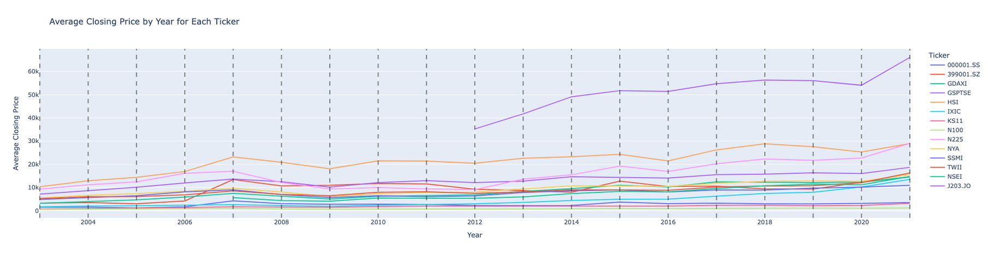
Data Exploration
Index | Percentage Change | Duration (Years)
IXIC | 881.30% | 18.38
399001.SZ | 432.54% | 18.40
GDAXI | 415.24% | 18.39
KS11 | 394.36% | 18.40
TWII | 252.88% | 18.39
NSEI | 246.70% | 13.70
N225 | 241.15% | 18.40
NYA | 223.09% | 18.38
HSI | 200.90% | 18.39
GSPTSE | 193.48% | 18.39
000001.SS | 163.51% | 18.39
SSMI | 134.03% | 18.38
N100 | 130.88% | 18.40
J203.JO | 98.57% | 9.31
Converted columns into proper datatypes (string to double/int)
Detected data discrepancies before March 1, 2003, and adjusted dateset to start at the date
Utilized spark.sql to gain a better understanding of the data:
Total count of each index
Average closing for each index
Max closing for each index
Total volume for each index
Performance over time for each index
Identified two indexes for further machine learning (IXIC and NYA)

Slide 9
Data Cleaning

Slide 10
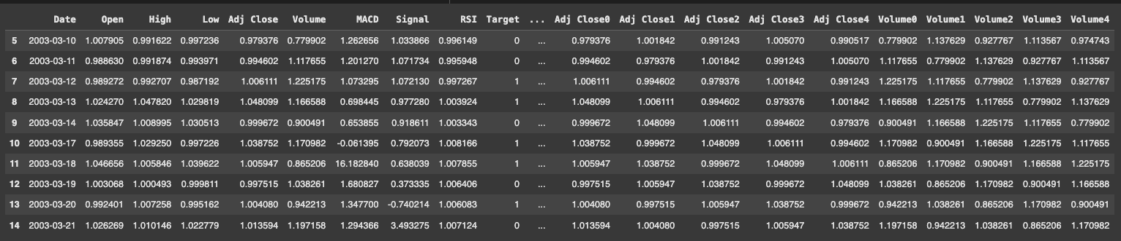
Data Cleaning
Converted pyspark data frame to pandas dataframe with the data filter of March 01, 2003
Created two new data frames based on index (IXIC and NYA)
Dropped all NULL/NaN values
Enriched the dataset by adding three new columns (MACD, Signal, RSI)
Further enriched the dataset to show one week history
Used custom scaling
Created Target and Feature dataset for machine learning
Target = “Target”
Features = “Open”, “High”, “Low”, “Adj Close”, “Volume”, “MACD”, “Signal”, “RSI”, “Adj Close0”, “Adj Close1”, “Adj Close2”, “Adj Close3”, Adju Close4", “Volume0”, “Volume1”, Volume2", “Volume3

Slide 11
Machine Learning

Slide 12
Logistic Regression
IXIC
NYA
The model performs better for class 1 than for class 0, with higher F1-scores (0.75 vs. 0.63) and recall (0.76 vs. 0.61).
The overall accuracy is 70%, meaning 70% of predictions are correct.
The macro and weighted averages for precision, recall, and F1-score are around 0.69–0.70, showing reasonably balanced performance across both classes.
The lower recall for class 0 indicates the model struggles to identify some instances of this class, which may require improvement.
The model performs better for class 1 than for class 0, with higher F1-scores (0.75 vs. 0.68).
The overall accuracy is 72%, indicating correct predictions in 72% of cases.
The macro and weighted averages for precision, recall, and F1-score are all 0.72, reflecting balanced overall performance.
The model is slightly less effective at identifying instances of class 0, as indicated by its lower metrics compared to class 1.
Classification Report | Classification Report | Classification Report | Classification Report | Classification Report
 | Precision | Recall | F1-Score | Support
0 | 0.65 | 0.61 | 63.00 | 576
1 | 0.73 | 0.76 | 0.75 | 801
Accuracy |  |  | 0.70 | 1377
Macro Avg | 0.69 | 0.69 | 0.69 | 1377
Weighted Avg | 0.70 | 0.70 | 0.70 | 1377
Classification Report | Classification Report | Classification Report | Classification Report | Classification Report
 | Precision | Recall | F1-Score | Support
0 | 0.68 | 0.68 | 0.68 | 598
1 | 0.75 | 0.75 | 0.75 | 774
Accuracy |  |  | 0.72 | 1372
Macro Avg | 0.72 | 0.72 | 0.72 | 1372
Weighted Avg | 0.72 | 0.72 | 0.72 | 1372

Slide 13
Decision Tree
IXIC
NYA
The model performs slightly better for class 1 compared to class 0, as reflected in the higher precision, recall, and F1-score for class 1 (0.71 vs. 0.64 for class 0).
The overall accuracy of the model is 68%, indicating that 68% of all predictions are correct.
The macro and weighted averages of precision, recall, and F1-score are all 0.68, suggesting reasonably balanced performance across classes.
The recall for class 0 (0.65) indicates that the model struggles slightly more with identifying actual instances of class 0 compared to class 1.
The model performs slightly better for class 1 compared to class 0, as shown by the higher recall (0.85 vs. 0.79) and F1-score (0.83 vs. 0.80) for class 1.
The overall accuracy is 82%, indicating that 82% of all predictions are correct.
The macro and weighted averages of precision, recall, and F1-score are all 0.82, reflecting well-balanced performance across both classes.
The model demonstrates robust performance, with strong metrics for both classes, though there is room for improvement in recall for class 0 to ensure consistent identification of actual instances.
Classification Report | Classification Report | Classification Report | Classification Report | Classification Report
 | Precision | Recall | F1-Score | Support
0 | 0.64 | 0.65 | 0.64 | 612
1 | 0.72 | 0.71 | 0.71 | 765
Accuracy |  |  | 0.68 | 1377
Macro Avg | 0.68 | 0.68 | 0.68 | 1377
Weighted Avg | 0.68 | 0.68 | 0.68 | 1377
Classification Report | Classification Report | Classification Report | Classification Report | Classification Report
 | Precision | Recall | F1-Score | Support
0 | 0.81 | 0.79 | 0.80 | 630
1 | 0.82 | 0.85 | 0.83 | 742
Accuracy |  |  | 0.82 | 1372
Macro Avg | 0.82 | 0.82 | 0.82 | 1372
Weighted Avg | 0.82 | 0.82 | 0.82 | 1372

Slide 14
Random Forest
IXIC
NYA
The model performs better for class 1 compared to class 0, with higher precision (0.73 vs. 0.65), recall (0.76 vs. 0.61), and F1-score (0.75 vs. 0.63).
The overall accuracy is 70%, meaning 70% of all predictions are correct.
The macro averages for precision, recall, and F1-score are all 0.69, indicating slightly imbalanced performance between the two classes.
The lower recall for class 0 (0.61) suggests that the model struggles to identify actual instances of class 0, which may require improvement depending on the use case.
The model demonstrates strong performance, with high F1-scores of 0.88 for class 0 and 0.90 for class 1.
The overall accuracy is 89%, indicating that the model makes correct predictions 89% of the time.
The macro and weighted averages for precision, recall, and F1-score are all 0.89, showing balanced performance across both classes.
Slightly higher recall and F1-score for class 1 suggest the model is marginally better at identifying and predicting instances of class 1.
Classification Report | Classification Report | Classification Report | Classification Report | Classification Report
 | Precision | Recall | F1-Score | Support
0 | 0.65 | 0.61 | 63.00 | 576
1 | 0.73 | 0.76 | 0.75 | 801
Accuracy |  |  | 0.70 | 1377
Macro Avg | 0.69 | 0.69 | 0.69 | 1377
Weighted Avg | 0.70 | 0.70 | 0.70 | 1377
Classification Report | Classification Report | Classification Report | Classification Report | Classification Report
 | Precision | Recall | F1-Score | Support
0 | 0.88 | 0.87 | 0.88 | 630
1 | 0.89 | 0.90 | 0.90 | 742
Accuracy |  |  | 0.89 | 1372
Macro Avg | 0.89 | 0.88 | 0.89 | 1372
Weighted Avg | 0.89 | 0.89 | 0.89 | 1372

Slide 15
Ensemble - Support Vector Classification (SVC)
IXIC
NYA
Meta-Model Accuracy:
Achieved a test accuracy of 59.8% using the ensemble approach.
Ensemble Strategy:
Combined predictions from Logistic Regression, Decision Tree, and Random Forest models.
Support Vector Classifier (SVC) served as the meta-model for final predictions.
Key Process:
Stacked predictions from base models as input to SVC with a polynomial kernel (degree=10).
Benefit:
Balanced performance with lower computational cost compared to more complex models like deep neural networks.
Meta-Model Accuracy:
Achieved a significantly improved test accuracy of 79.08% using the ensemble approach.
Ensemble Strategy:
Combined predictions from Logistic Regression, Decision Tree, and Random Forest models.
SVC with a polynomial kernel (degree=10) was used as the meta-model for final predictions.
Key Process:
Stacked probabilities from base models as input to the SVC meta-model.
The trained meta-model leveraged the diverse strengths of base models for better generalization.
Benefit:
Achieved a robust and accurate ensemble model with less computational cost compared to deep neural networks.

Slide 16
Ensemble Reasoning - This Strategy Mitigates Weaknesses
Model | Weakness | How the Ensemble Mitigates the Weaknesses
Logistic Regression | Struggles with non-linear patterns. | SVC and Decision Tree handle non-linear relationships.
Decision Tree | Overfits the training data. | Random Forest reduces overfitting with bagging.
Random Forest | Can produce overly smoothed or generalized results. | Decision Tree captures finer details in data.
The SVC learns from these diverse strengths and weaknesses and forms a more balanced and accurate final model.

Slide 17
AdvancedMachine Learning

Slide 18
Why Deep Neural Network (DNN) ?
Unparalleled Advantages despite being computationally intensive.
DNNs excel in capturing intricate relationships between features—something traditional models often struggle with.
A well-tuned DNN offers the ability to generalize learnings far more effectively than traditional models.
Its advanced capabilities like automatic feature extraction, the ability to model complex temporal dependencies, adaptability to non-linear and high-dimensional data, and scalability across diverse datasets make it possible achieve a deeper understanding of patterns and relationships, ultimately delivering more robust and accurate predictions.

Slide 19
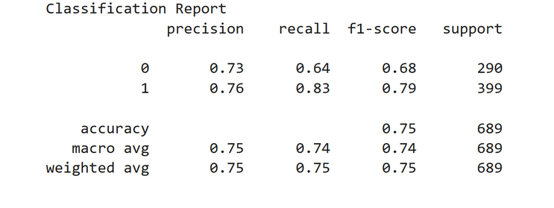
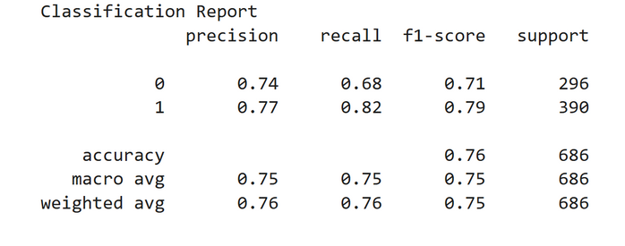
Neural Network
IXIC
NYA
The model predicts changes in the NASDAQ (IXIC) index price.
The model predicts changes in the NYSE (NYA) index price.
It performs better at predicting price increases (1) than decreases (0), with an overall accuracy of 75%.
It correctly identifies 83% of actual increases (high recall), and 76% of predicted increases are accurate (precision).
For decreases, it identifies 64% correctly but with lower precision (73%).
This suggests the model is more reliable for predicting index rises, but improving its ability to detect decreases could enhance its balance and overall utility for investment strategies.
It performs better at predicting price increases (1) than decreases (0), with an overall accuracy of 76%.
It correctly identifies 82% of actual increases (high recall), and 77% of predicted increases are accurate (precision).
For decreases, it identifies 68% correctly but with slightly lower precision (74%).
This suggests the model is more reliable for predicting index rises, but improving its ability to detect decreases could enhance its balance and overall utility for investment strategies.

Slide 20
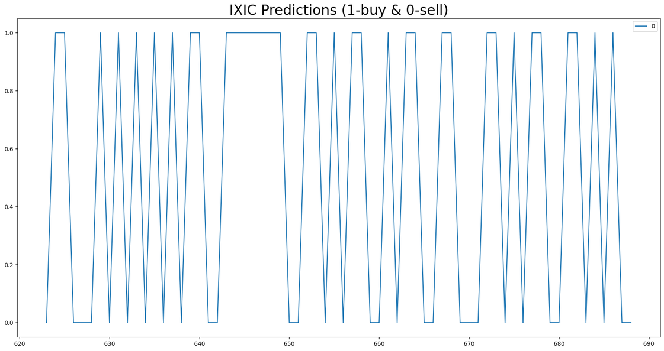
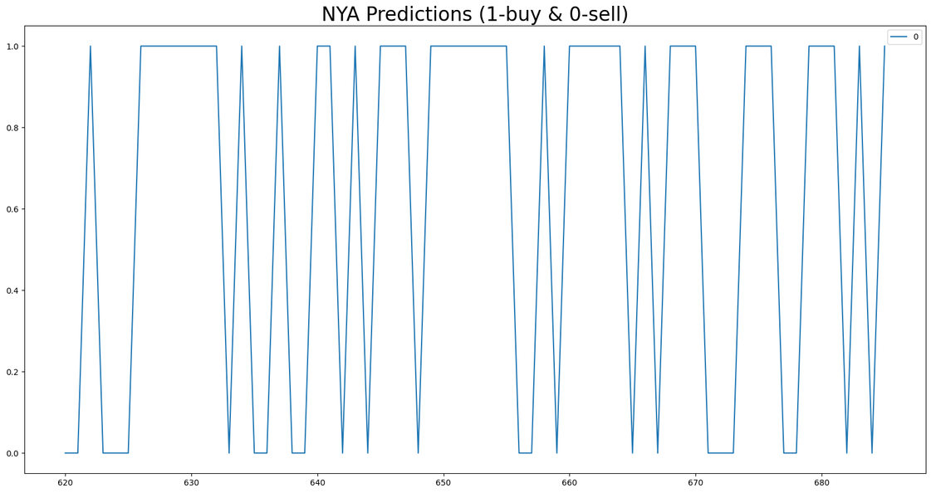
Volatility Interpretation
IXIC
NYA
IXIC Predictions
The predictions for IXIC (1 for buy, 0 for sell) exhibit frequent and rapid oscillations.
The market behavior is highly volatile, with minimal stability in the trend.
This suggests a market prone to significant price fluctuations and sharp changes in direction.
NYA Predictions
The predictions for NYA also show volatility but with fewer oscillations compared to IXIC.
There are longer periods of consistent predictions (sustained buy or sell signals), indicating more stable phases in the market.
This suggests a relatively less reactive market compared to IXIC.
dnn_test_predictions= mdl.predict(Xtest) #Sigmoid output in probability values between 0 -1
dnn_binary_predictions = (dnn_test_predictions > 0.5).astype(int) #post processing for binary output

Slide 21
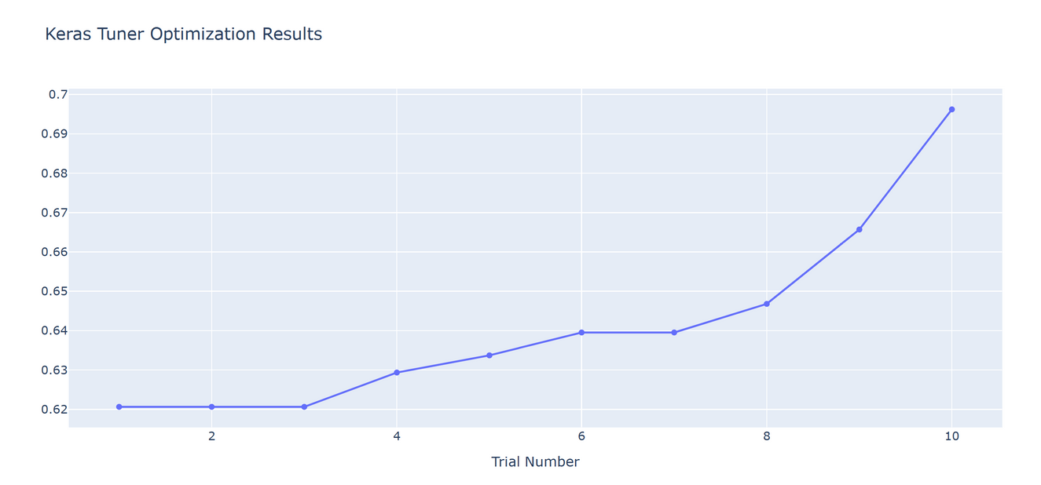
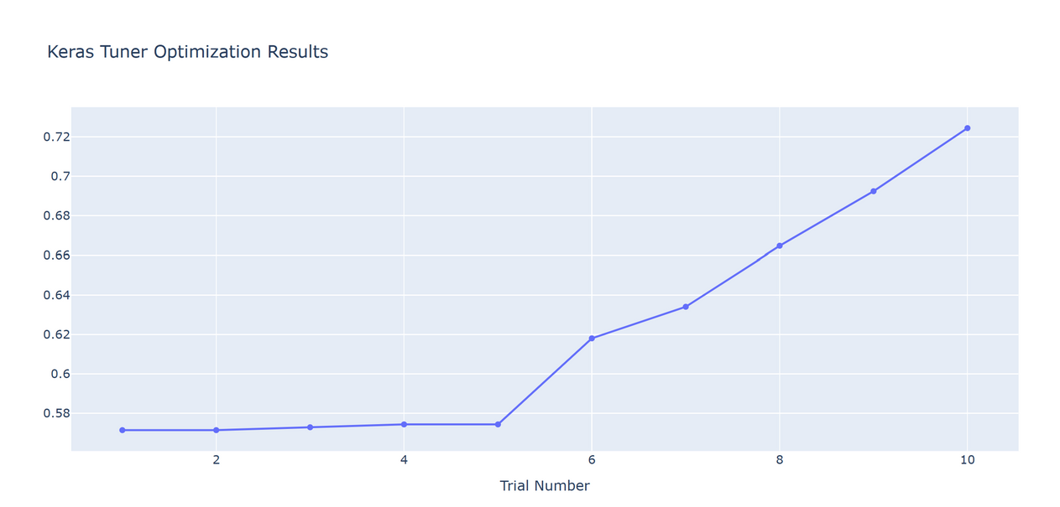
Neural Network - Optimizations
IXIC
NYA
Early Trials (1–4):
The performance metric starts at around 0.62 and remains relatively flat with minor improvements.
Indicates that the initial hyperparameter configurations were not optimal.
Improvement Phase (5–9):
Gradual improvement is observed, with the performance metric climbing steadily.
Suggests that the tuner is narrowing down better hyperparameter configurations.
Final Trial (10):
The performance metric reaches 0.7, which is the highest in the trials.
Indicates that the best-performing hyperparameter combination was found during this trial.
Early Trials (1–5):
The performance metric remains relatively stagnant (around 0.58–0.6).
This indicates that the initial hyperparameter configurations may not have been optimal.
Improvement Phase (6–10):
From trial 6 onwards, the performance begins to improve steadily.
This suggests that the tuner is identifying better hyperparameter combinations, resulting in a more optimized model.
Final Trial (10):
The performance metric reaches its peak at around 0.72.
This is likely the best hyperparameter combination found during the tuning process.

Slide 22
DNN Ensemble - Key Points
Ensemble Preparation :
Top 5 models were saved from different epochs during DNN training.
During training, the model passes through different "states" at each epoch. Early epochs might capture broader patterns, while later epochs may overfit to the training data.
Ensemble Effect:
Ensembles generally perform better than individual models by reducing variance in predictions, reducing the risk of overfitting, and smoothing out noise.
Improved Generalization:
By combining predictions from multiple saved models, the final prediction is less dependent on any single model's biases.

Slide 23
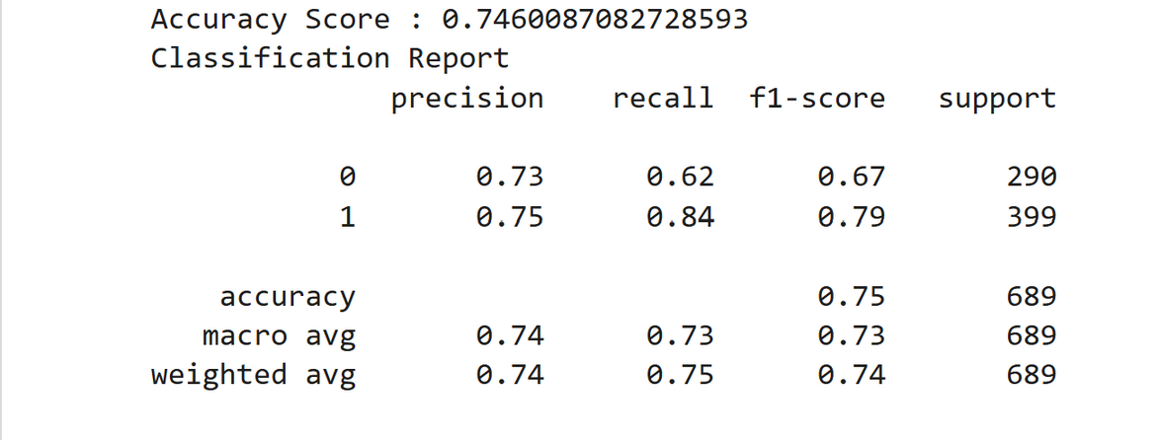
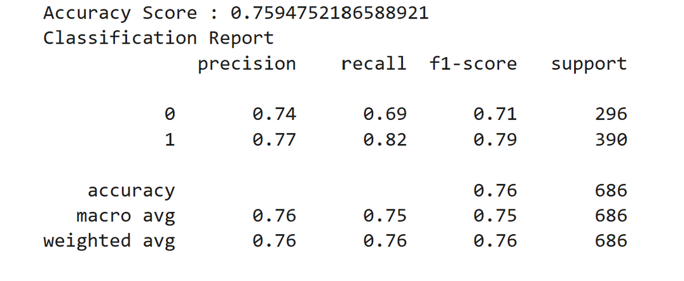
Ensemble - Averaging Top Models
IXIC
NYA
It performs better at predicting price increases (1) than decreases (0), with an overall accuracy of 75%.
It correctly identifies 84% of actual increases (high recall), and 75% of predicted increases are accurate (precision).
For decreases, it identifies 62% correctly but with slightly lower precision (73%).
This suggests the model is more reliable for predicting index rises, but improving its ability to detect decreases could enhance its balance and overall utility for decision-making.
It performs better at predicting price increases (1) than decreases (0), with an overall accuracy of 76%.
It correctly identifies 82% of actual increases (high recall), and 77% of predicted increases are accurate (precision).
For decreases, it identifies 69% correctly but with slightly lower precision (74%).
This suggests the model is more reliable for predicting index rises, but enhancing its ability to detect decreases could improve its balance and utility for decision-making strategies.

Slide 24
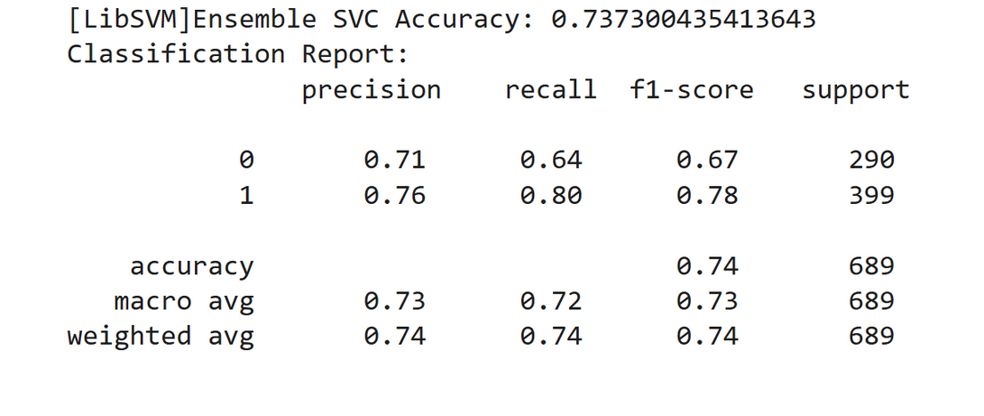
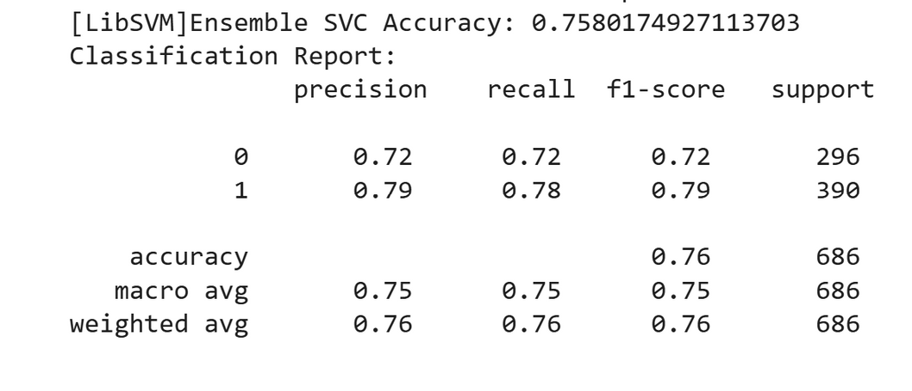
Ensemble - Support Vector Classification (SVC)
IXIC
NYA
It performs better at predicting price increases (1) than decreases (0), with an overall accuracy of 73.7%.
It correctly identifies 80% of actual increases (high recall), and 76% of predicted increases are accurate (precision).
For decreases, it identifies 64% correctly, with a precision of 71%.
This indicates that the ensemble SVC model is more reliable at predicting increases, but its performance on decreases is comparatively weaker, suggesting room for improvement in balancing class predictions.
It performs better at predicting price increases (1) than decreases (0), with an overall accuracy of 75.8%.
It correctly identifies 78% of actual increases (high recall), and 79% of predicted increases are accurate (precision).
For decreases, it identifies 72% correctly, with an equivalent precision of 72%.
This suggests the ensemble SVC model achieves a balanced performance between detecting increases and decreases, but improving its precision and recall for decreases could further enhance its utility.

Slide 25
Stacking multiple models in an SVC model proves better than Averaging
Evidence: Improved balance between precision and recall for price decreases(0), especially for NYA.
Reasoning: Stacking leverages the strengths of a meta-model (SVC) to learn patterns and relationships in the predictions from multiple models.

Slide 26
Answers at a Glance
Comparability of the IXIC and NYA Stock Indexes
Predictability
NYA achieves a slightly higher overall accuracy (76%) compared to IXIC (74%) in predicting price increases and decreases.
Both models are more reliable for predicting price increases than decreases, but NYA demonstrates better balance between the two classes. This indicates that the NYA model is more effective for investment strategies requiring both accuracy and balance.
What will be the change (higher or lower) in the opening price of the next day as compared to the opening price of the current day for an index?
Volatility
IXIC: Exhibits frequent and rapid oscillations between buy (1) and sell (0), indicating high volatility and minimal stability in trends. The market is prone to sharp price fluctuations and direction changes.
NYA: Shows fewer oscillations with longer periods of consistent buy or sell signals, reflecting lower volatility and relatively more stable market behavior compared to IXIC.
How can the market volatility be interpreted using a machine learning model?
The model that was closest to 90% accuracy was Random Forest
This model with the highest accuracy can be a potent advisor if it shows a consistent prediction close to 90% accuracy over time in different market conditions..
The alternative to that is a more robust and ensembled DNN model, while slightly less accurate, offers robustness and adaptability. For the NYA index, this model provides balanced predictions and performs well in capturing complex patterns.
Reliability
Can a model be trained with near about 90% accuracy to be a potent advisor for investing in the stock market?

Slide 27
Conclusion
NYA is a stronger choice for investment over IXIC
The evaluation of traditional and advanced machine learning models, along with various optimization strategies, suggests that NYA is a stronger choice for investment. Its stable market trends, balanced predictions, and higher reliability in forecasting price movements make it a preferable option, particularly for investors seeking consistency and reduced risk. In contrast, IXIC's higher volatility may appeal to risk-tolerant investors aiming for potentially higher, yet less predictable returns.

Slide 28
Questions

